Slide 1
Agile Fundamentals
A Course from ThoughtWorks Studios
CONFIDENTIAL AND RESTRICTED.
These materials are for the sole use of the individuals to whom they were delivered, and any further copying or distribution is prohibited.
Notes:
Hello, and welcome to The Origins of Agile Software Development, a module in Agile Fundamentals. This module is brought to you by ThoughtWorks Studios, makers of Mingle, Go, and Twist.

Slide 2
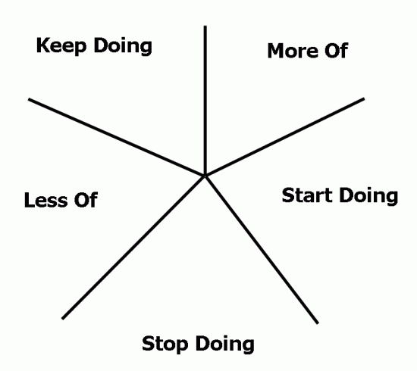
Starfish

Slide 3
Where do we go from here?
More Training – Skills (Deep)
More Training – Product
Coaching - pilot project(s)
More Training (AF) - Broad
Adoption Plan
Id Process and technical practices

Slide 4
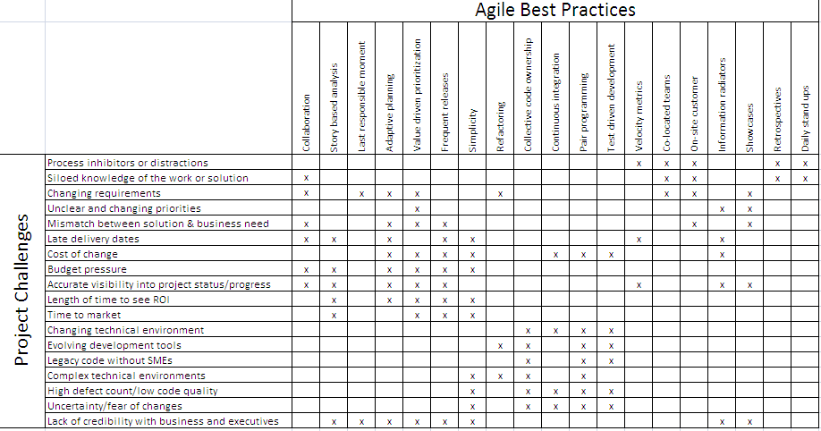
Agile adoption plan
Agile Proven Practices

Slide 5
Agile Proven Practices
Automated
Build/Deploy
Short
Releases
Pair
Programming
IKO/IPM
Retrospectives
Automated
Testing
Card Wall
Refactoring
Daily
Stand-ups
Collective
Ownership
Simple Design
Coding
Standards
Velocity
Metrics
Iterations
Co-location
Test Driven
Development
User
Stories
Sustainable
Pace
On-site
Customer
Continuous
Integration
INDIVIDUAL
TEAM
ORGANIZATIONAL
Notes:
Review and ask if there are any questions about any of the concepts.

Slide 6


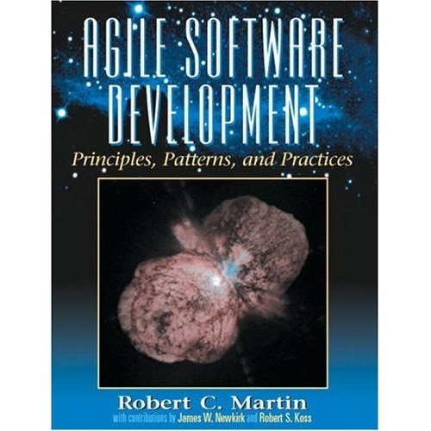



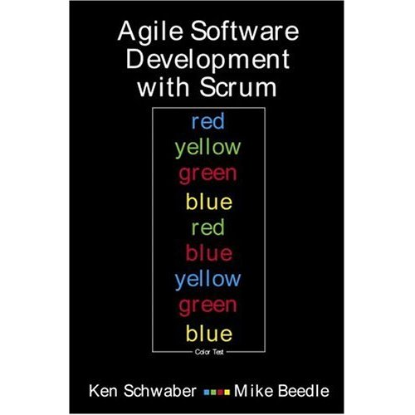


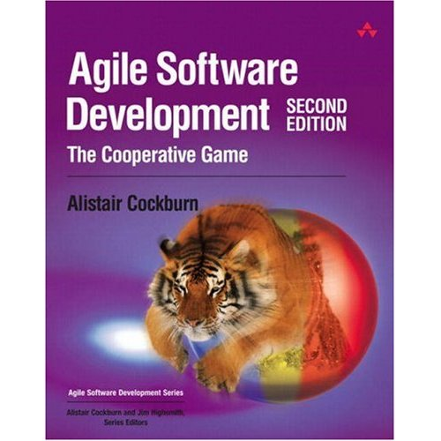



Notes:
There are lots of books on the subject of agile development, and you may want to reads some of them for yourself.

Slide 7
Questions?

